Slide 1
LUNG AND COLON CANCER DETECTION USING DEEP LEARNING
Unnati Mehta
Ankuran Chattoraj
Akarsh Singh

Slide 2
Why is the detection of lung and colon cancer important
Early detection of lung and colon cancer is pivotal, significantly impacting survival rates and treatment effectiveness.
Timely identification allows for more manageable and less aggressive treatments, potentially preventing the spread of cancer to other vital organs.
Ultimately, early detection not only enhances patient outcomes but also reduces mortality rates and improves the overall quality of life for individuals diagnosed with these cancers.

Slide 3
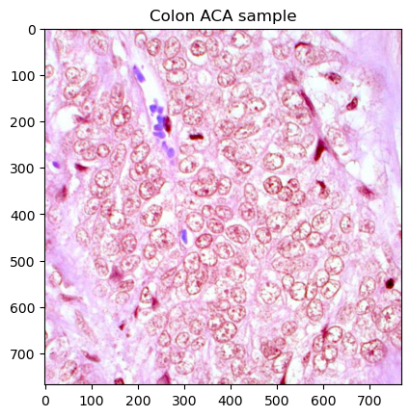
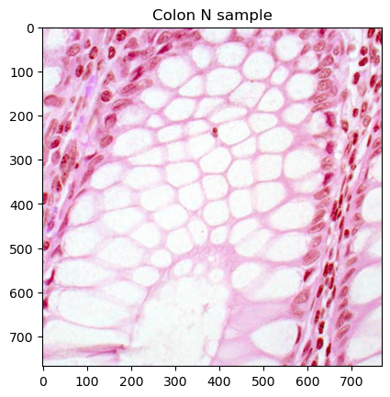
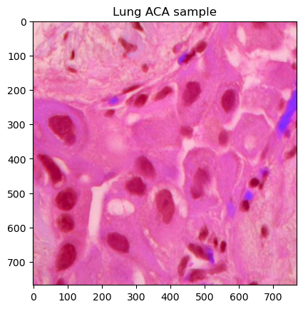
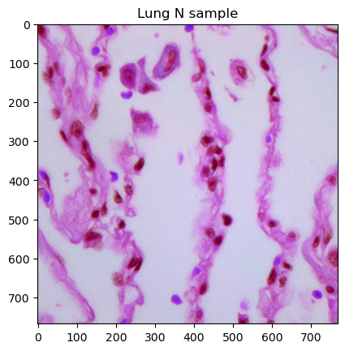
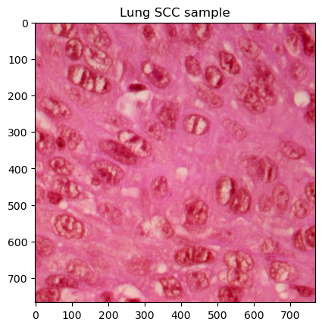
Data
25000 total images for 5 different classes.
#5000
#5000
#5000
#5000
#5000
Lung Squamous Cell Carcinoma
Colon Adenocarcinoma
Colon Benign Tissue
Lung Adenocarcinoma
Lung Benign Tissue

Slide 4


Model development process
Create CNN Model
Analyzing Performance and Result Inference
Increase Model Complexity
Fixed Hyperparameters For Loading Data
Batch Size 64 Adam Optimizer Categorical Cross Entropy Loss
Image Normalization /255 Train/Validation/Test (70/15/15) Stratified Sampling

Slide 5
MODEL ARCHITECTURE BREAKDOWN
Baseline CNN Deeper CNN with Batch Norm Advanced Architectures
Input Size 80 x 80 x 3
3 Convolution Layers
2 x 2 Max Pooling
ReLU Activation Functions
1 Fully Connected Layer
1 Output Layer
25 Epochs
Least Number of Parameters
Input Size 224 x 224 x 3
4 Convolution Blocks (x2)
2 x 2 Max Pooling
ReLU Activation Functions
Dropout
Batch Normalization
2 Output Layers
10 Epochs
50% More Parameters
Input Size 224 x 224 x 3
Weights from ImageNet
ReLU Activation Functions
Dropout
2 Output Layers
5 Epochs

Slide 6
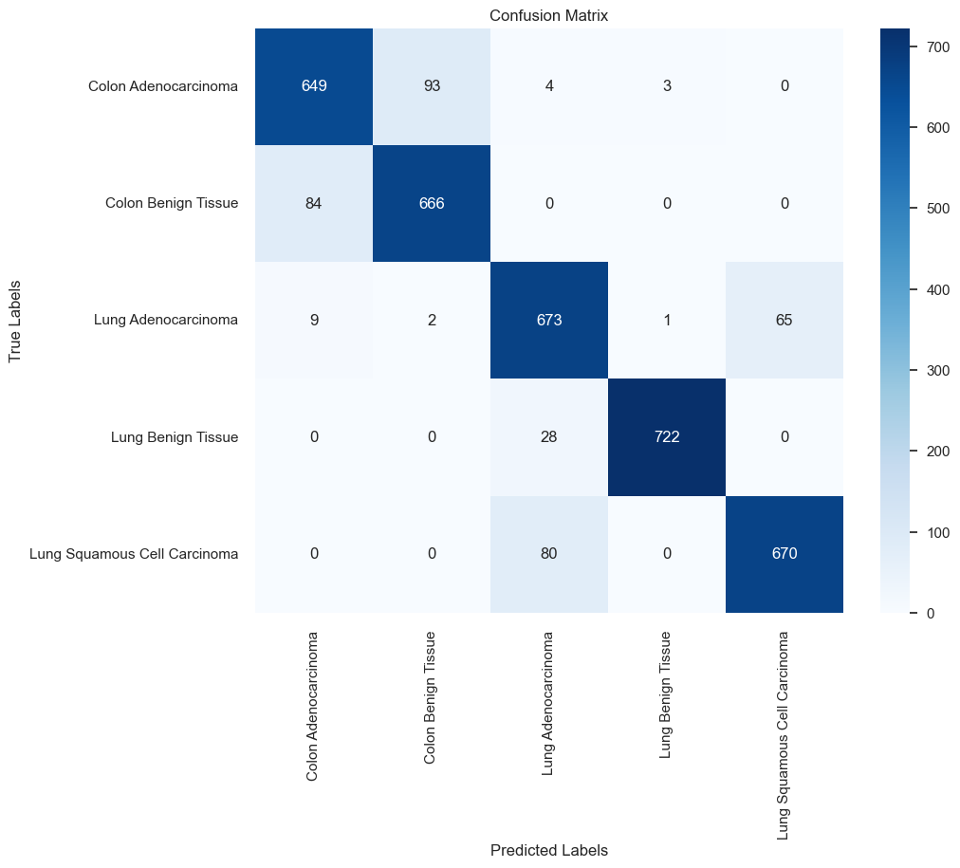
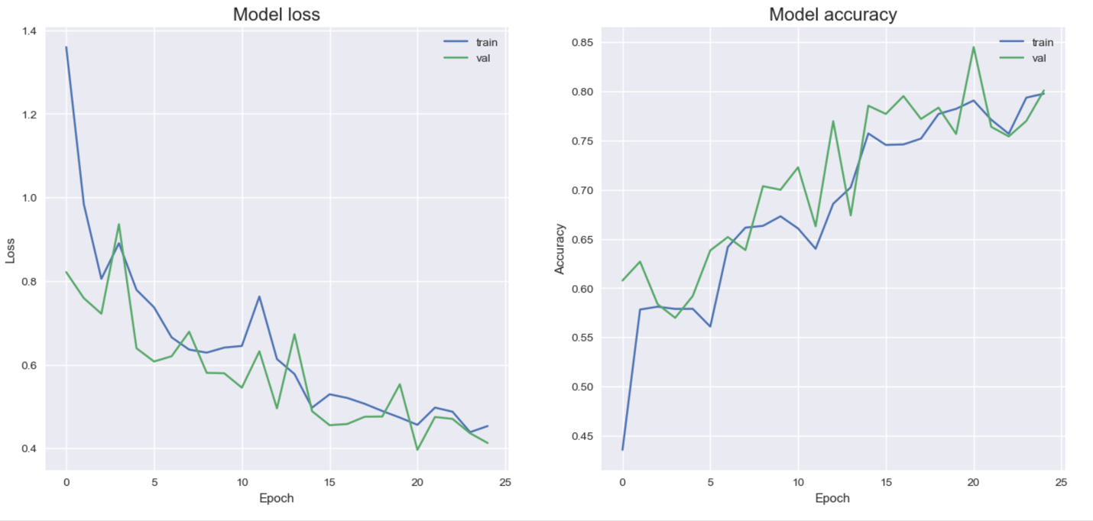
BASE CUSTOM CNN PERFORMANCE

Slide 7
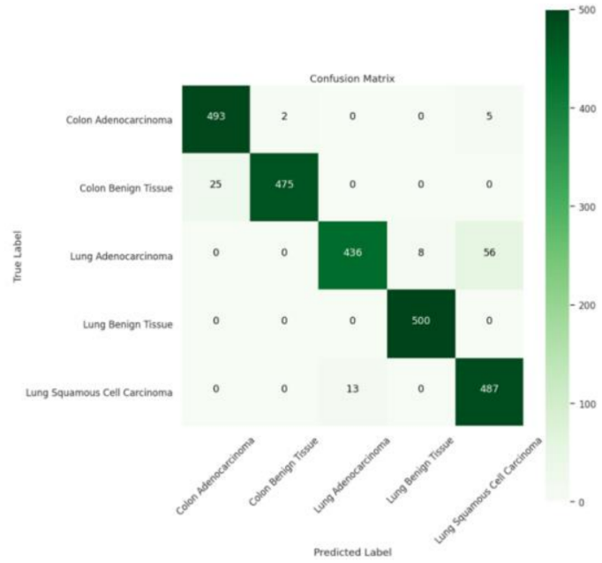
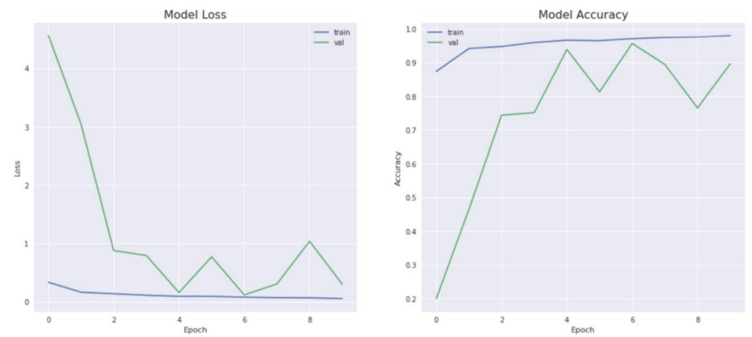
ADVANCED CUSTOM CNN PERFORMANCE

Slide 8
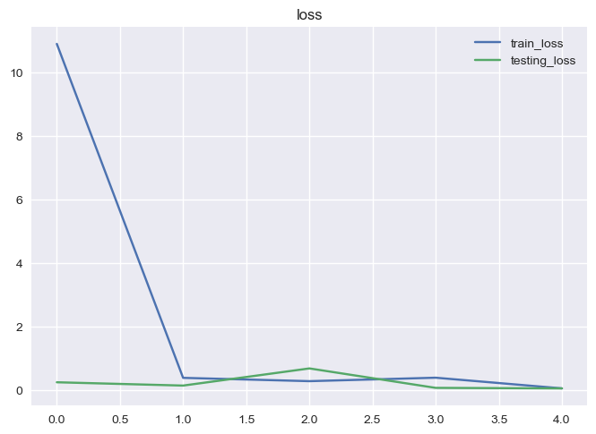
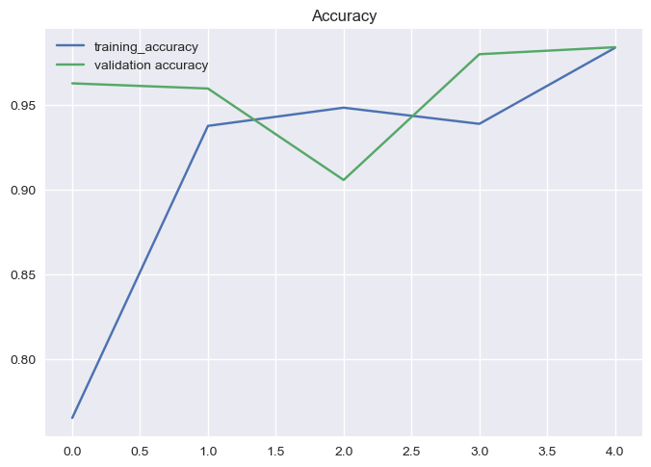
RESNET 101
Adopted ResNet-101 architecture for transfer learning evaluation.
Highest number of parameters, necessitating a limitation to 5 epochs due to computational intensity.
Despite the limited epochs, achieved impressive 98% accuracy.

Slide 9
RESULTS
ResNet101: Achieved the highest accuracy of 98%, demonstrating exceptional predictive capabilities. However, it requires longer computational time due to its complex architecture.
Deep CNN: Showcased strong performance with an accuracy of 92%, excelling particularly in non-cancerous lung tissue prediction.
Base CNN: Achieved a respectable accuracy of 80%, displaying consistent performance in the lung and tissue classification task.
ResNet101 offers exceptional accuracy but demands more computational resources, suitable for scenarios where high accuracy is critical and computational time is not a limiting factor.
01
Further optimization strategies for ResNet101's computational efficiency could leverage its superior accuracy without compromising significantly on computational time.
02

Slide 10
Future Directions
Optimize resources and reduce computational costs.
Investigate alternative model architectures like Unet and VGGnet.
Address challenges in classifying specific categories.
Explore adaptability to new data distributions.

